Slide 1

Register
CSE 4205 Digital Logic Design
Course Teacher: Md. Hamjajul Ashmafee
Lecturer, CSE, IUT
Email: ashmafee@iut-dhaka.edu

Slide 2
Remaining to Add
Review other books and internet resources
Bi-directional register
Check my previous hand-note

Slide 3
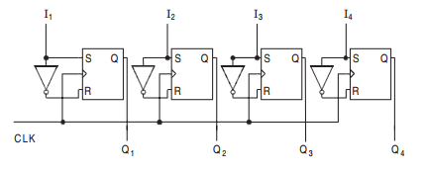
Introduction
A group of binary cells that can hold binary information
Normally, a group of flip flops makes a register
n bit register has n flip flops to hold n bits of information
A register may have an additional combinational circuit that performs data processing task

Slide 4
Basic of A Register
Registers are considered as MSI
All the flip flop has a common clock pulse to enable at the same instant
Generally, negative edge triggered or master-slave type flip flop are used
These kinds of flip flops are called gated latch which have third input to activate them
Registers could be designed with S-R, J-K and D flip flops
T flip-flop is not preferred here.

Slide 5
Shift Register: Classification
Direction of shifting
It is capable of shifting its binary contents either to the right or to the left
Right Shift
Left Shift
Types of shifting
Serial shifting
Shift one bit at a time for each clock pulse in a serial manner starting with LSB or MSB
Parallel shifting
All the data bits shift simultaneously during a single clock pulse
Quicker than serial shifting operation

Slide 6
Shift Register: Different Classifications
Unidirectional Shift Register
Transfer data in only one direction (Left or Right)
Bidirectional Shift Register
Transfer data in both right and left direction
Universal Shift Register
Transfer data in both right and left direction along with the necessary input and output terminals for parallel transfer

Slide 7
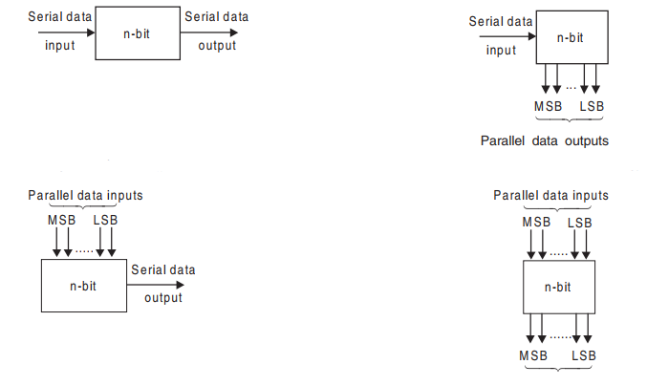
Shift Register: Basic Types
SISO (IC 74L91)
SIPO (IC 74164)
PISO (IC 74265)
PIPO (IC 74198)

Slide 8
Shift Register - SISO
Input data – serially through a single input line
Output data – also serially through a single output line
Note: If a new data bit is inserted into register from one end, on the other end, previously stored data bit will be shifted out
Very similar to the concept of “queue”
Types based on direction of shifting
Left shift register
Data shifts from right to left
Right shift register
Data shifts from left to right

Slide 9
Shift Register – SISO…
Clock pulse is applied to all flip flops simultaneously
If we want to get complete data available in register, we have to wait until n^{th} clock cycle for n bit register
To get the last inserted bit as output from the last flip flop (Q_{n}), we need to wait (n-1) clock cycles more
In total (2n-1) clock cycles to achieve full data as output serially
In the mean time, the register will be reset with output 0

Slide 10
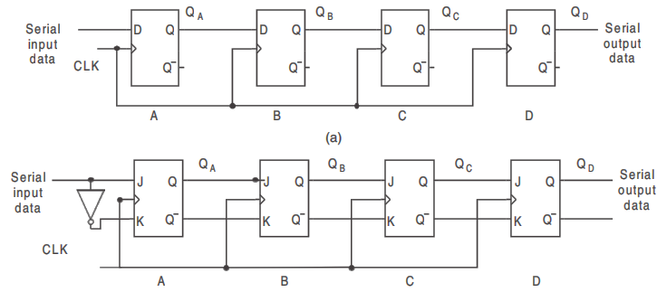
Shift Register – SISO – Right shift Circuit Diagram
Using D flip flop
MSB
LSB
Using JK flip flop
Notes:
Insertion starts with LSB

Slide 11
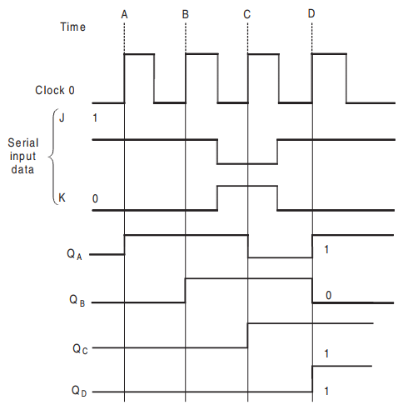
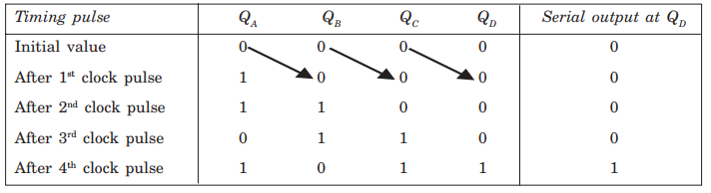
Shift Register – SISO – Right shift… Example with Data “1011”
Notes:
Output is updated during clock transition from 0 to 1 (Positive edge trigger).
At first 1 is inserted, then another 1, then 0 and finally 1. Started from LSB.

Slide 12
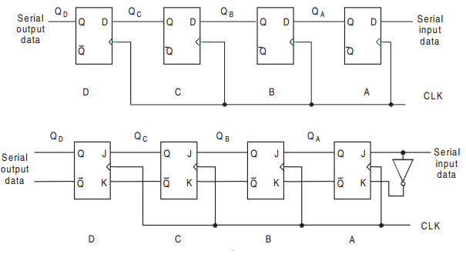
Shift Register – SISO – Left shift Circuit Diagram
Using D flip flop
LSB
MSB
Using JK flip flop

Slide 13
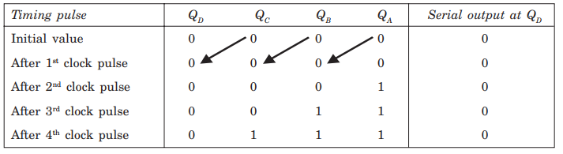
Shift Register – SISO – Left shift… Example with Data “1110”

Slide 14
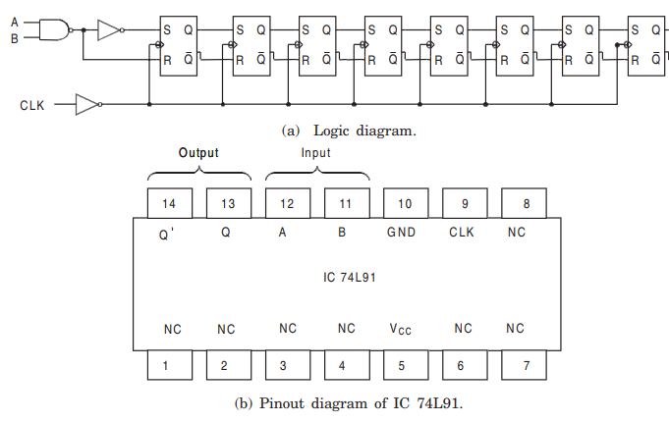
8 Bit SISO Shift Register IC
Notes:
NC = no connection or normally closed
Gating function to an input = a combinational circuit part before an input
If that combinational circuit part is not required, A and B should be sorted (connected)

Slide 15
Shift Register – SIPO
Property: Data is shifted serially, but shifted out in parallel
All the outputs should be available at the same time by connecting the output of each flip flop to an output pin
If the data is stored in the flip flops, instantly they are available in the output
Flop flops should be edge triggered or master slave flip flop to avoid any kind of glitch
Note: Clear input could be applied to reset all flip flops
During inserting (input) data hold and set-up time should be maintained
Notes:
Set up time = time for data at synchronous input to be stable before active edge of clock pulse
Hold time = time for data at synchronous input to be stable after active edge of clock pulse

Slide 16
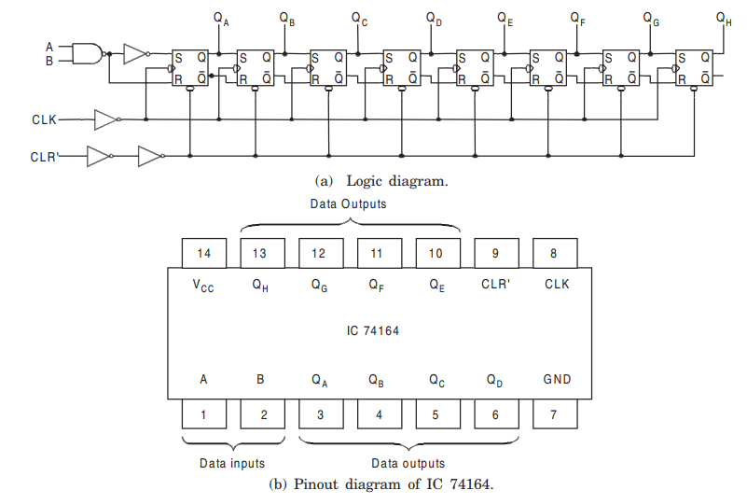
8 Bit SIPO Shift Register IC

Slide 17
Shift Register – PISO
Property: Data is entered in parallel manner into the register
A control input (Shift/Load) is required to allow the all input data bits either to enter into the register in parallel or to shift the data in serial
Shift signal enables the gates to allow the data bits to shift right or left
Load signal enables the other gates to allow the data bits at the parallel inputs to be entered

Slide 18
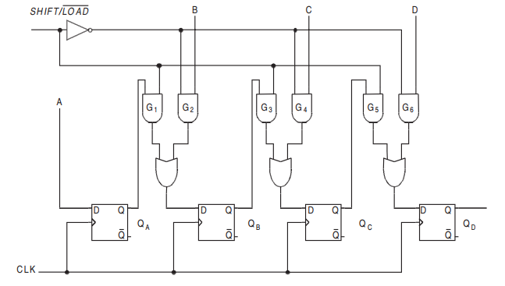
Shift Register – PISO… Circuit Diagram

Slide 19
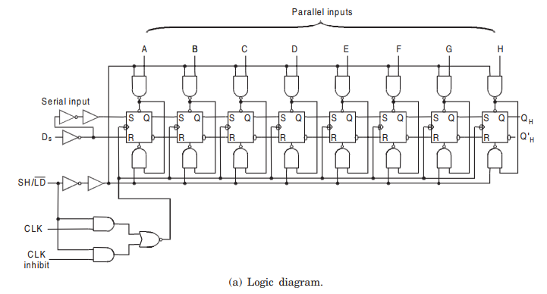
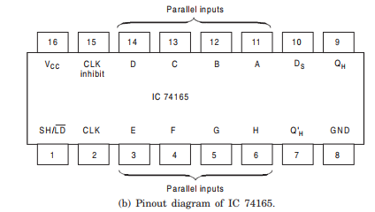
8 Bit PISO Shift Register IC

Slide 20
Shift Register – PIPO
Property: Data can be shifted into or out of the register in parallel
No interconnection between the flip flops as no serial shift is required
When the data entry is accomplished at the parallel inputs, that data will be available at the parallel outputs instantly
An application of active clock pulse is required to perform this task as well
More pins are required in the IC to accommodate all inputs and outputs

Slide 21
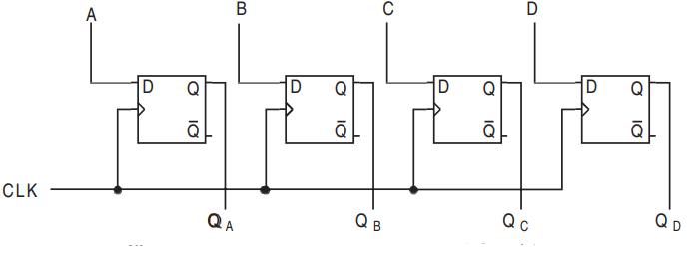
Shift Register – PIPO… Circuit Diagram

Slide 22
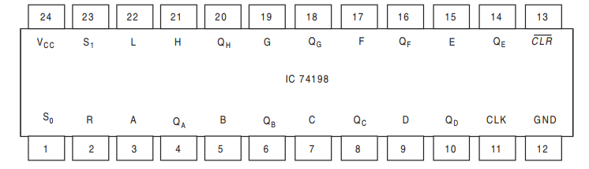
8 Bit PIPO Shift Register IC
Notes:
This circuit also can be used for:
SIPO – when A (pin 3) will be used for input in serial
PISO – when Q_{H} (pin 20) will be used for output in serial

Slide 23
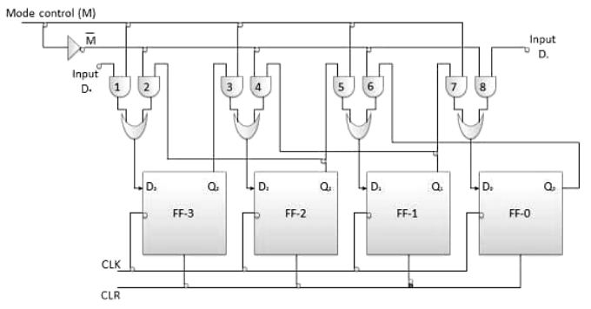
Bidirectional Shift Register
Notes:
Capable of transferring data in both directions (Left and Right) based on control input (M)

Slide 24
Universal Register
Right or Left shift control input
To enable the shift operation in a particular direction
Parallel load control
To enable a parallel transfer with n parallel input or output lines
Clear input
To reset the register
Another control input also can be applied to keep the data in the register unchanged

Slide 25
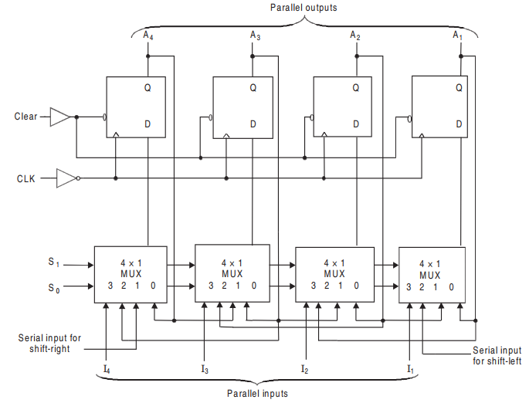
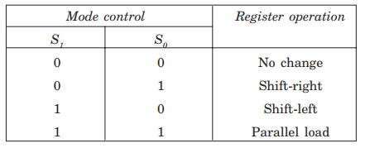
4 Bit Universal Register: Circuit Diagram
Notes:
All four multiplexers are embedded inside the register

Slide 26
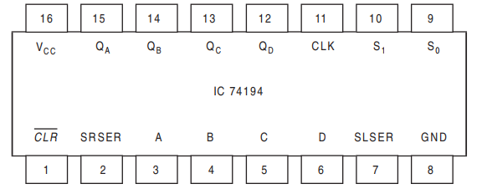
4 Bit Universal Register: IC Pinout Diagram
Notes:
SRSER (Pin 2) = Shift Right Serial Input
SLSER (Pin 7) = Shift Left Serial Input
S1 and S0 (Pin 9 and 10) for selection of Multiplexer

Slide 27
Register used as Counter
Ring Counter
Johnson Counter
They will be discussed in the chapter of “Counter”

Slide 28
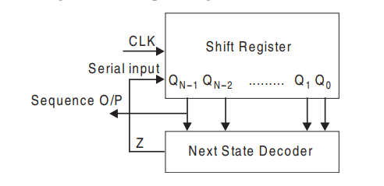
Sequence Generator
Basic concept:
A circuit that generates a desired sequence of bits in synchronization with a clock
Usage: Random bit generator, code generator, prescribed period generator
Construction: using a shift register and next state decoder
Sequence Output is generated from Q_{n-1} output pin
Next state decoder is a function of (Q_{n-1}, Q_{n-2}, … Q₁, Q₀)
Its output is connected to the input of the shift register

Slide 29
Design a 4-bit Sequence Generator
Sequence: 1001; sequence length, N= 4
Minimum number of flip-flops n
Where, N ≤ 2^{n} – 1
Here , n=3
If these three flip-flops doesn’t satisfy all possible states we should increase the number of flip-flops

Slide 30
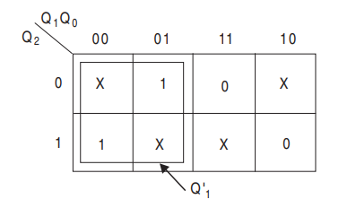
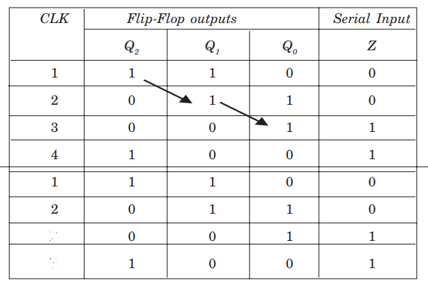
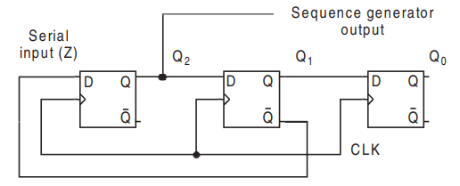
Design a 4-bit Sequence Generator…
In the table, Z is true for two times only.
Z=Q₁’
3
4
Here, Four states are different.
Logic for next state decoder.
Notes:
Q2 column lists the sequence 1001,
Q1 and Q0 are the same sequence delayed by one and two clock pulses respectively indicated by arrow.
Z column gives the serial input for the shift register at D2
Problem: What will be happened for initial time, when Q2, Q1 and Q0 store data randomly.
Possible solution: they should be initialized with a certain values of 0 or 1 individually for first clock pulse

Slide 31
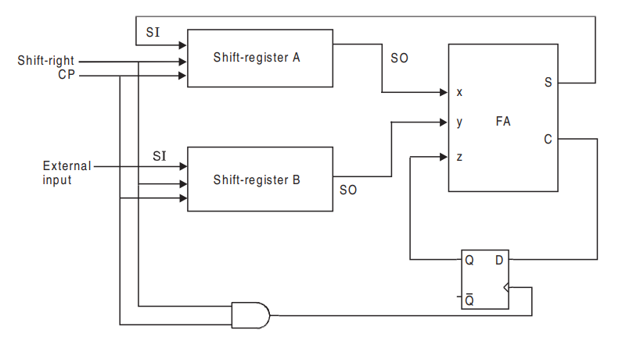
Serial Addition
Augend/Sum
Addend
Carry Flip-flop

Slide 32
Binary Divider
Home Task

Slide 33
Motivation

